Slide 1
CAS Applied Data Science
Module 3 – Data Analysis & Machine Learning
Predicting vote in the Swiss National Council
Lisa Asticher, Kim Lan Vu, Emilie Zucchinetti
Bern, December 12, 2022

Slide 2
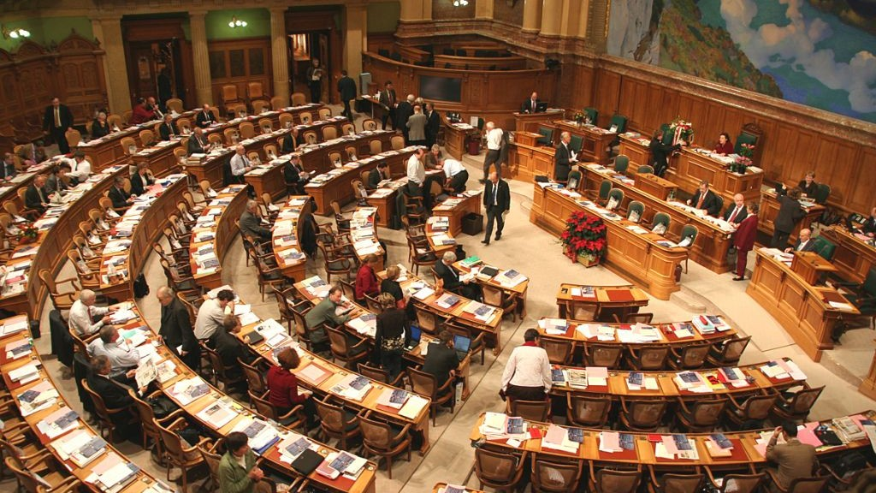
Introduction
The Swiss National Council is composed of 200 members and the seats are allotted to the 26 cantons on the basis of their resident population
Parliament holds four sessions a year – in March, June, September and December. Hundred of items are voted upon during each session.
Each Council member belongs to one of the six parliamentary groups, representing the major parties in Switzerland

Slide 3
Objective
Predict votes in the Swiss National Council,
based on Council members attributes and vote topics

Slide 4
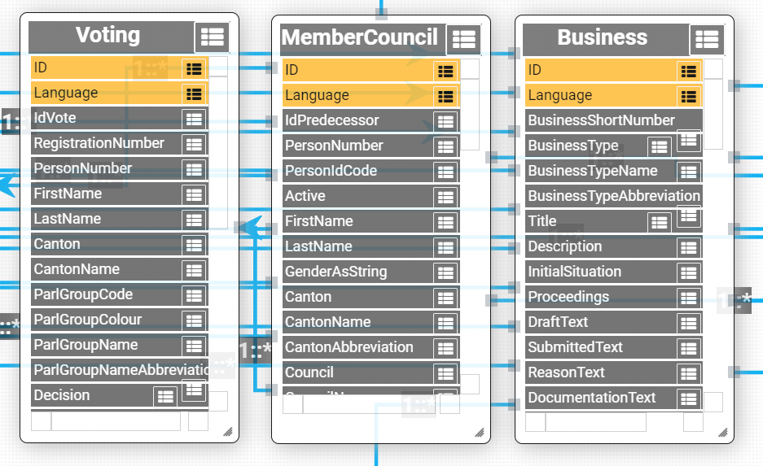
Data
Public API: https://ws.parlament.ch/odata.svc
Voting: data about votes
Business: data about vote themes
MemberCouncil: personal data about Council member

Slide 5
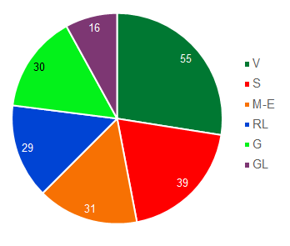
Council members variables
Age and gender
Canton
Language region (Swiss-german, Swiss-french, Swiss-italian), derived from the Canton
Parliamentary groups: People's group (V), Social Democrats (S), Center group (M-E), Liberals (RL), Green (G), Green Liberals (GL)
🡪 Grouping in 3 party groups: Left, Center, Right
Number of Council members in each parliamentary groups, 04.12.2019
Source: www.parlament.ch

Slide 6
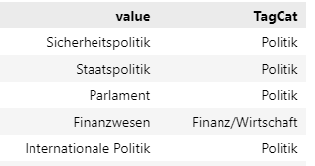
Business variables
Business tags (28): Sicherheitspolitik, Finanzwesen, Umwelt, Europapolitik,….
🡪 Grouping in 7 categories: Politik, Recht, Sozial, Energie/Umwelt/Land, Finanz/Wirtschaft, Kultur, Bildung/Wissenschaft
🡪 Vote can belong to one or several categories
Departments responsible for the business item (10): 7 departments, Parlement, Chancellery, Federal Court

Slide 7
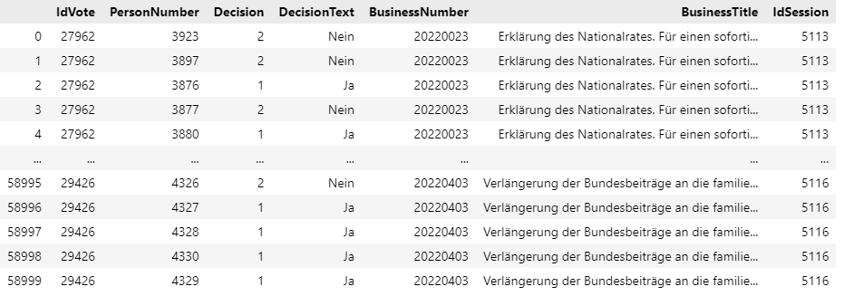
Voting variables
Vote decision (yes, no, abstention)
Absences and «not voting» dropped.

Slide 8

Data processing
Filter data from last 4 sessions
Request data in batches to overcome limit
Convert all variables into numerical values
Final dataset: 49’871 rows × 24 columns, 24 variables
Data collected on 22.11.2022

Slide 9
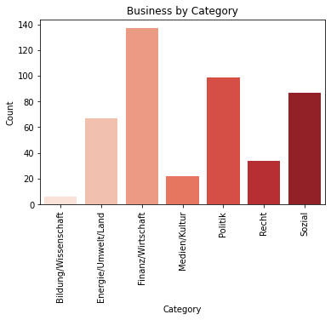
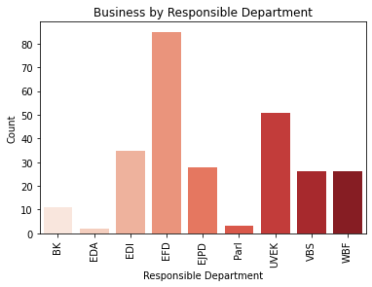
Descriptive Statistics - Businesses N=267

Slide 10
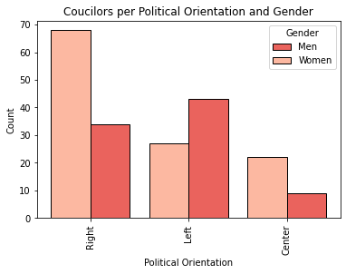
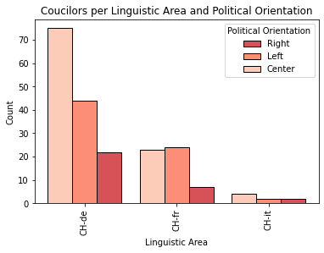
Descriptive Statistics - Councilors N=203

Slide 11
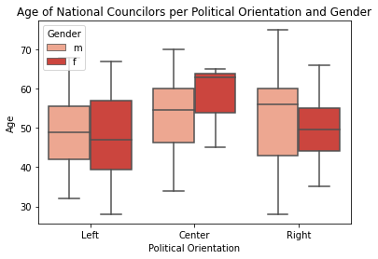
Descriptive Statistics - Councilors N=203

Slide 12
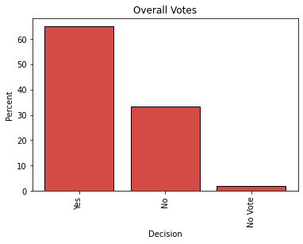
Descriptive Statistics - Votes N=49’871

Slide 13
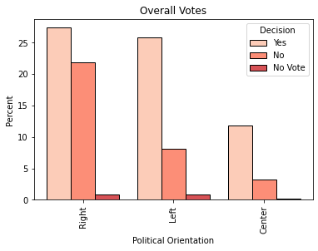
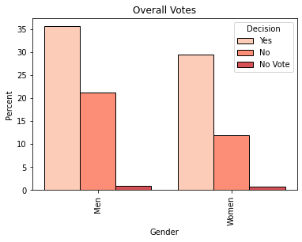
Descriptive Statistics - Votes N=49’871

Slide 14
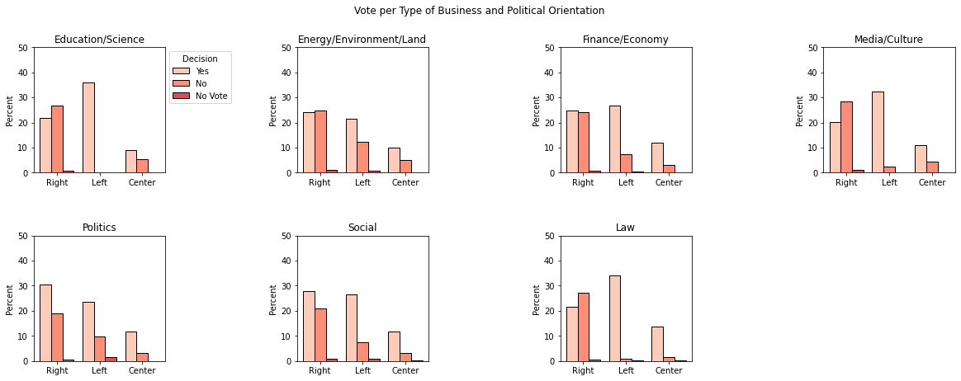
Descriptive Statistics - Votes N=49’871

Slide 15
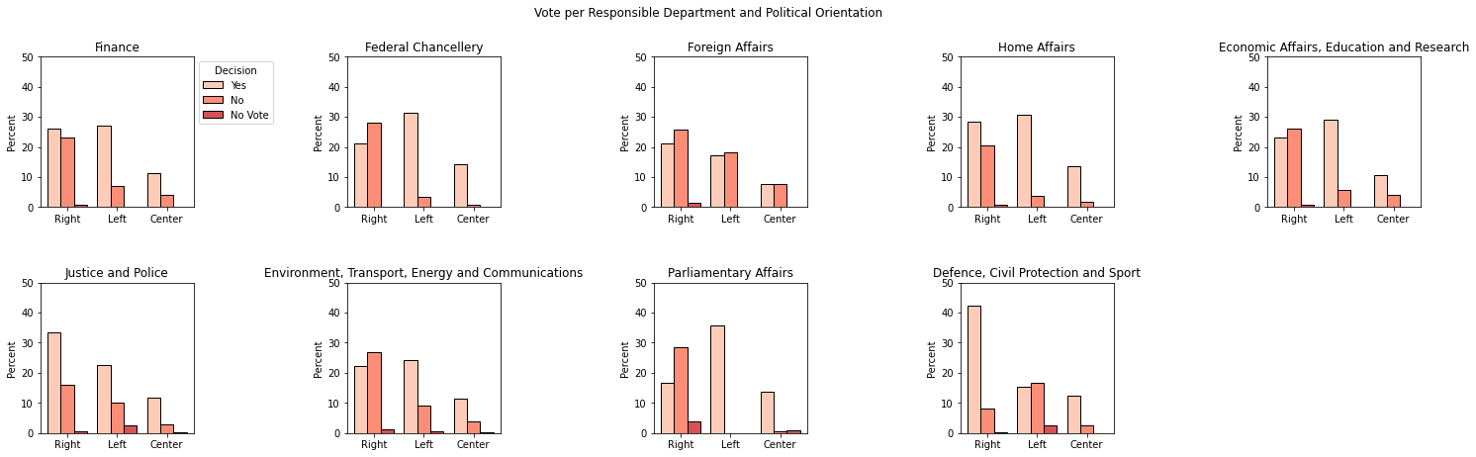
Descriptive Statistics - Votes N=49’871

Slide 16
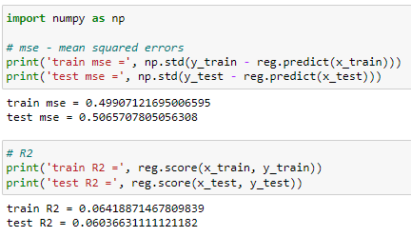
Algorithm – Linear Regression
We have a dataset of 49’871 observations over 24 variables.
We tried to apply first a linear regression with very little success
The classic linear regression models is not working at all. We obtain very bad results. We need to try a more complex model.

Slide 17
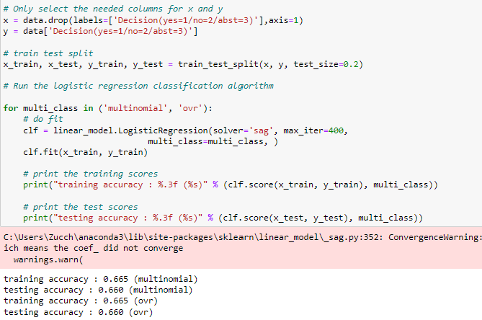
Algorithm – Logistic Regression
No matter the method (multinomial or ovr), the estimator does not converge, even by increasing the number of iterations up to 400 trials.
Moreover, as we increased the number of iterations, the training accuracy did not increase and stayed at around 65% which is slightly better than pure luck.

Slide 18
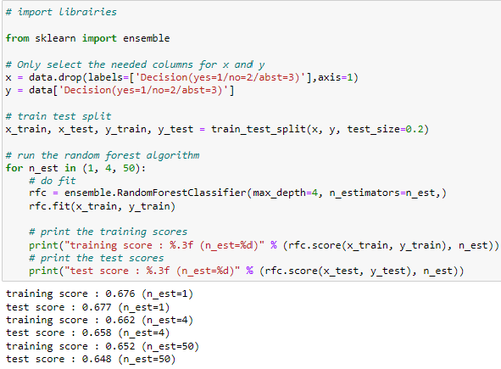
Algorithm – Decision trees (random forest)
By using a random forest, we obtain a maximum accuracy of around 68%
As we increased the number of estimators, the training and testing accuracy decreased. => Why?
We tried to use boosted decisions tress instead, the maximum accuracy obtained was 65%, so less good.

Slide 19
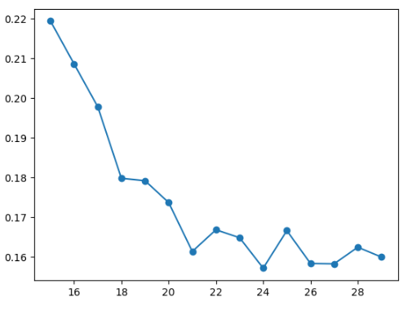
Algorithm – K-Means
By using a silhouette score, we identified 24 clusters.
However, when classifying the observations according to this model, we again obtain an accuracy of 65%, on both the training set and the test set.

Slide 20
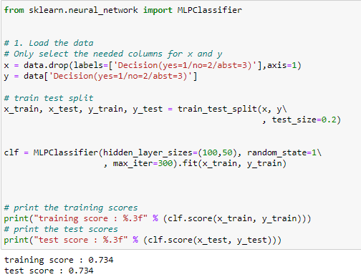
Algorithm – Multi-layer perceptron regressor
We now switch to neural networks.
We added 2 hidden layers of 100 and 50 neurons each. As a result the accuracy of the training and testing sets improved significantly (as well as computing time): we reach 73% of correct predictions in the test set.
It is a sign that more complex models could be more suited to this problem.

Slide 21
Conclusion
Transformation of categorical variables into numerical variables: is there another way to do it ?
The less complex algorithms achieve an accuracy of 65%. It’s better than random but not very high.
Neural networks show a better prediction score of 73%.
How can we improve accuracy ?
- do we need a larger dataset ? Probably not …
- refine Business data, category is too general and
doesn’t say anything about the orientation of the question

